Slide 1
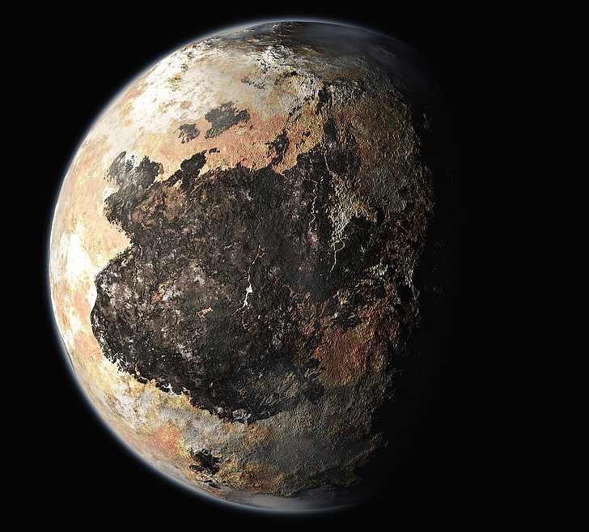

Pluto Ppt Grade 8
Made By Amraiel , Farhaan , Ayansh , Soham And Ria

Slide 2
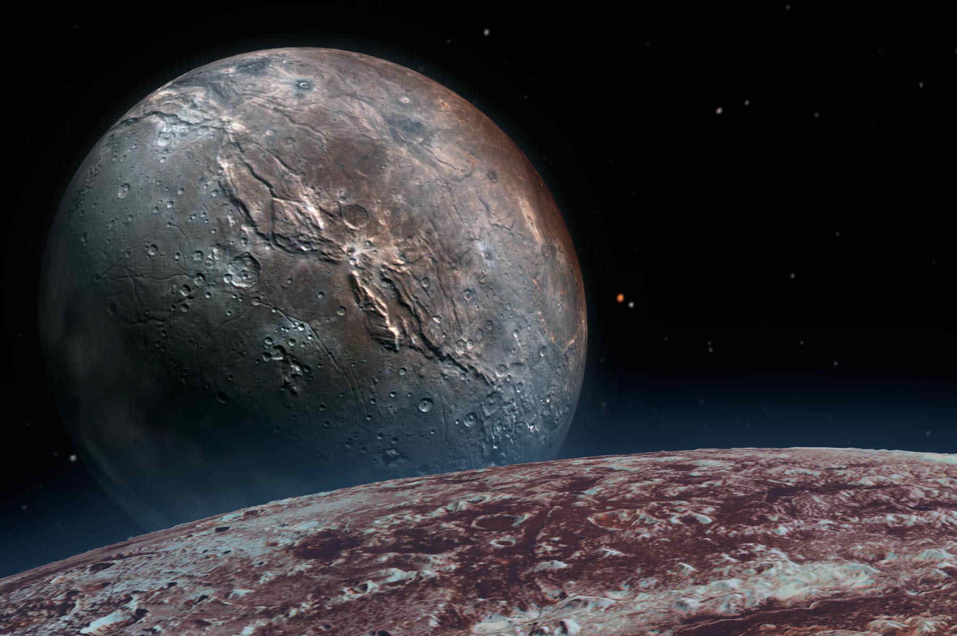
Facts About Pluto
The dwarf planet Pluto has five natural satellites. In order of distance from Pluto, they are Charon, Styx, Nix, Kerberos, and Hydra. Charon, the largest, is mutually tidally locked with Pluto, and is massive enough that Pluto and Charon are sometimes considered a binary dwarf planet.

Slide 3
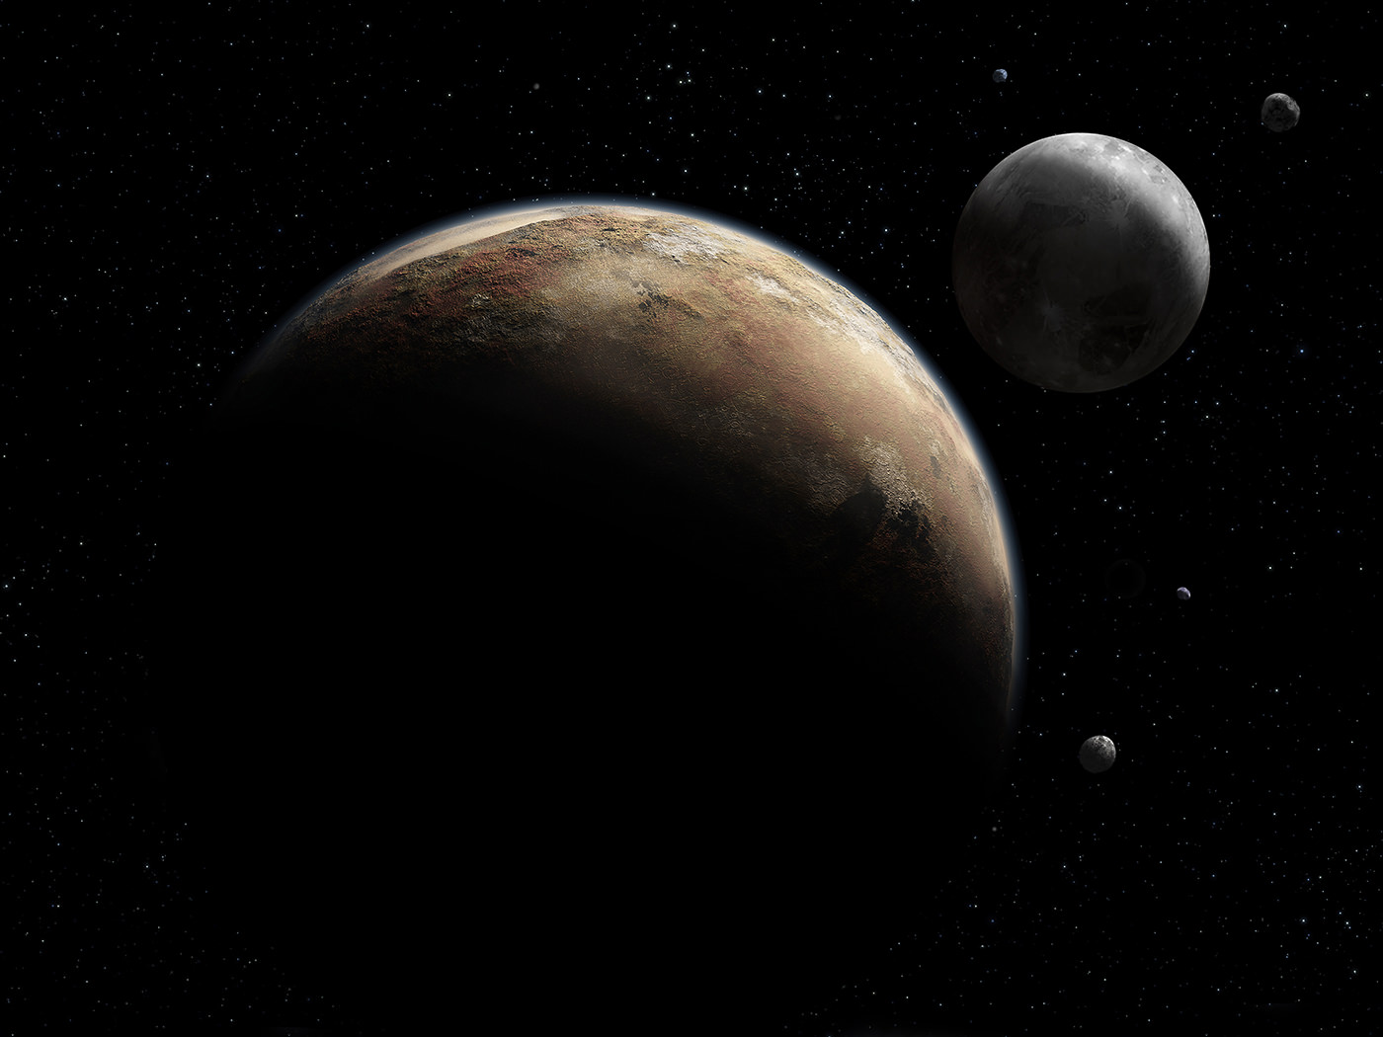
Profile Of Pluto
PLUTO DWARF PLANET PROFILE Diameter: 2,372 km Mass: 1.31 × 10^22 kg (0.17 Moons) Orbit Distance: 5,874,000,000 km (39.26 AU) Orbit Period: 248.0 years Surface Temperature: -229°C Moons: 5 (Charon) Discovery Date: February 18th 1930 Discovered By: Clyde W. Tombaugh.

Slide 4
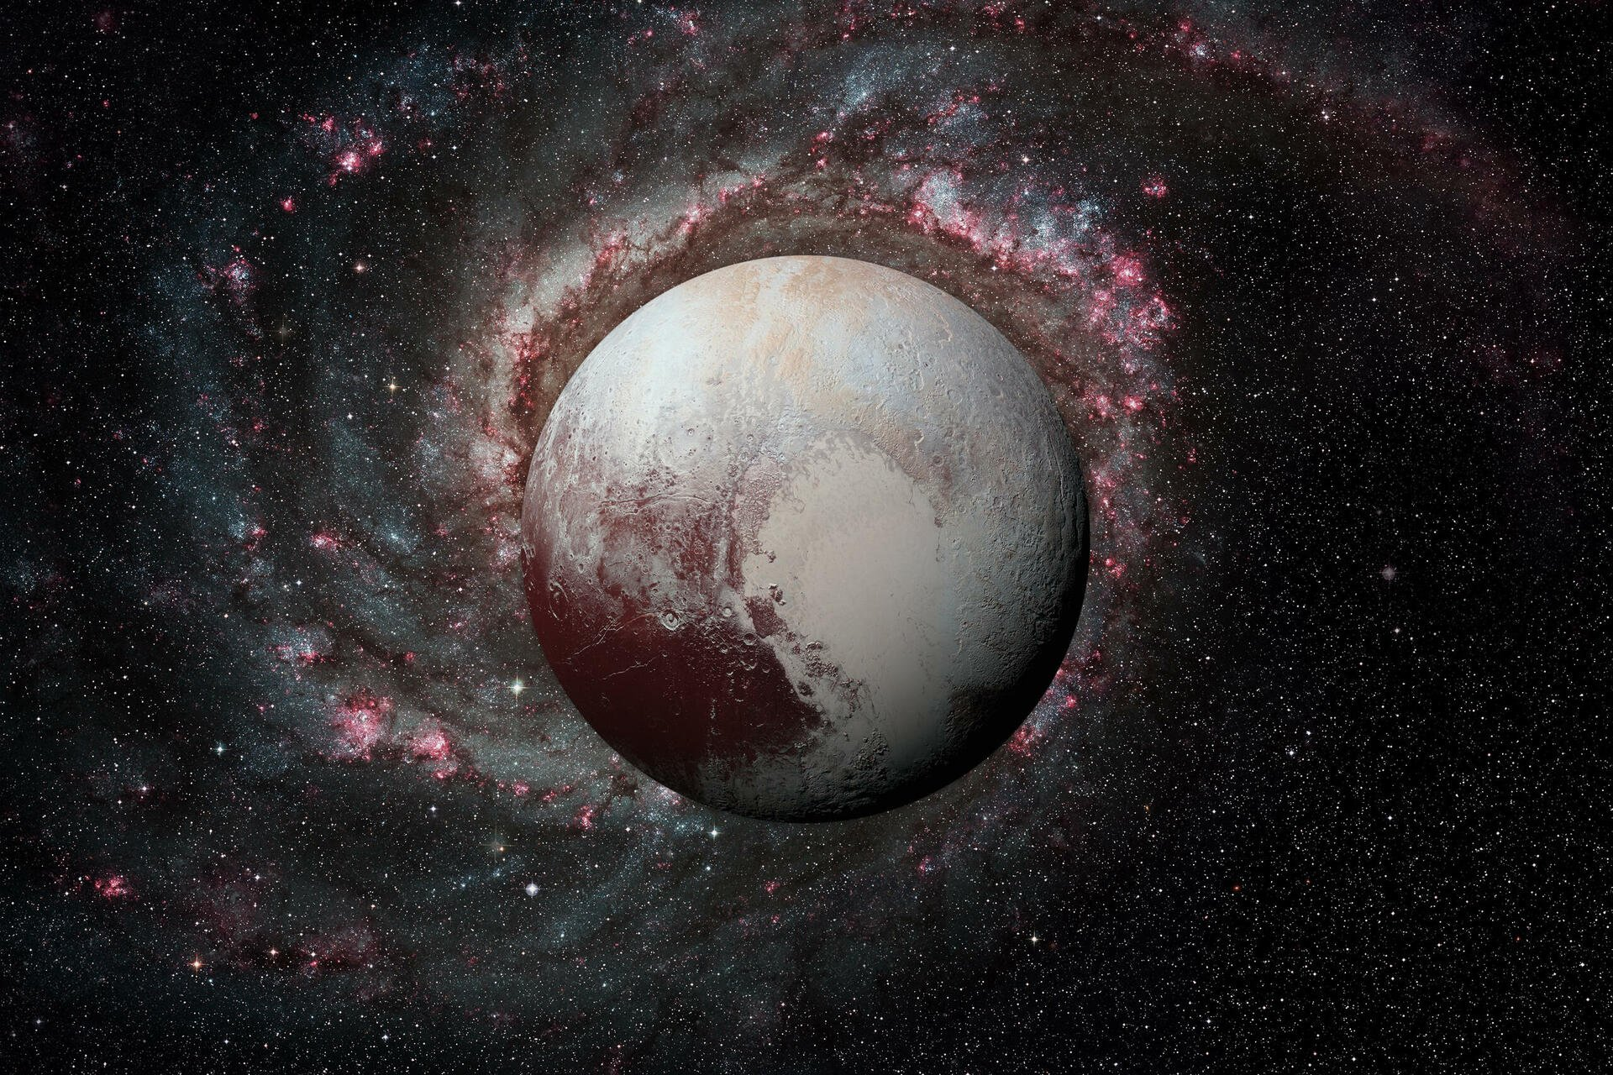
Information Of Pluto`
Pluto was reclassified from a planet to a dwarf planet in 2006. This is when the IAU formalised the definition of a planet as “A planet is a celestial body that (a) is in orbit around the Sun, (b) has sufficient mass for its self-gravity to overcome rigid body forces so that it assumes a hydrostatic equilibrium (nearly round) shape, and (c) has cleared the neighbourhood around its orbit.”

Slide 5
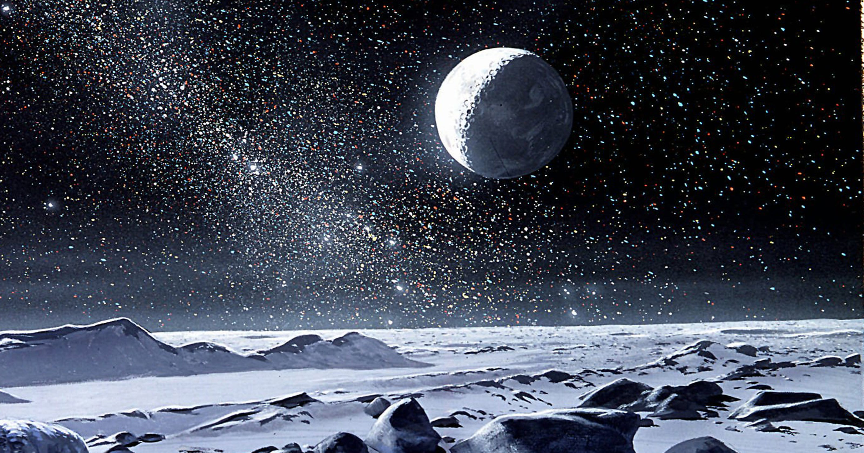
Questions And Answers Of Pluto`
Q1) Why is Pluto not a planet? Ans) The reason why Pluto is not a planet is because it does not meet all of the three requirements necessary to be categorized as one. More specifically, Pluto doesn’t have orbital dominance, that is to say, it hasn’t completely cleared its orbit of large objects and other debris. Planets usually do this by capturing or shooting out objects due to their large gravity force.

Slide 6
Questions And Answers Of Pluto`
Q2) Does Pluto have seasons? Ans)Pluto does have four seasons just like Earth. The reason why most planets and dwarf planets have seasons is because their axes are tilted in relation to the Sun. Some are only slightly tilted like Earth’s at 23°, and some are very titled like Pluto at 119°.

